Slide 1
Notes:
Introduction to Panel by MC (Steven Blaine)
(20 mins)
PANEL
Mike Morgan - Chair, WA Brewers Association
Kylie Lethbridge - CEO, Independent Brewers Association
Keith Warrick - Chair, SW Brewers Alliance
Susan Hall – Executive Director Agribusiness Food and Trade

Slide 2
Notes:
(MC Steven Blaine): Why have a WA Craft Beer Strategy? Perspectives from the Project Partners
Kylie Lethbridge - CEO, Independent Brewers Association
IBA National road map and state-based strategies – importance of partnering with state governments.
Mike Morgan - WA Brewers Association
- Aims to provide a pathway for the industry and government to work more closely over the coming decade with a vision of encouraging more opportunities for people to enjoy and experience the unique range of WA beers.
Keith Warrick - Chair, SW Brewers Alliance
Local perspective and alignment with Alliance activities. Each industry group (National, State and Local) has different functions but working to an agreed broader strategy
Susan Hall – Department of Primary Industries and Regional Development
- Contributes to the WA Government’s broader economic development framework ‘Diversify WA: Future State’, which provides a blueprint for collaboration between government, industry and the community, and supports WA Government’s focus on creating secure, quality jobs, growing and diversifying the economy and attracting investment.

Slide 3
Notes:
Susan Hall (cont_)
Beer manufacturing relies on agricultural inputs such as grains, hops, fruits, and other raw materials (for example indigenous native botanicals), and the industry requires equipment, machinery and packaging materials resulting in significant economic flow-on effects on various parts of the economy.
Breweries are also supported by a range of regionally based businesses that provide ingredients and services (transport and distribution, hospitality venues and retail services) supporting employment and regional income generation.
In the absence of a strategy the Agribusiness Food and Trade directorate of DPIRD has already been providing assistance as follows:
capability building workshops (Chris Baddock the keynote speaker today has been sponsored to run workshops in SW and Perth this week) and we have delivered domestic market pathways program, export workshops; digitalisation programs; ESG and circular economy events and we are pleased to sponsor today’s event.
Over the past five years the State Government has provided ~$6.6 million in grants to individual businesses to help grow the craft beer sector through a range of DPIRD schemes of assistance such as the Value-Add Investment Grants, Regional Economic Development grants of RDC’s; and Agrifood and Beverage Vouchers (which Rd 6 is currently open).
Wastewater management guidelines are available on the DPIRD website.
Local area business clusters promoting the SW Brewers Alliance and early strategy work has commenced with the WA Hop Growers Association.
Having this strategy will provide a more co-ordinated and planned approach to service delivery by DPIRD and other agencies in collaboration with industry.

Slide 4
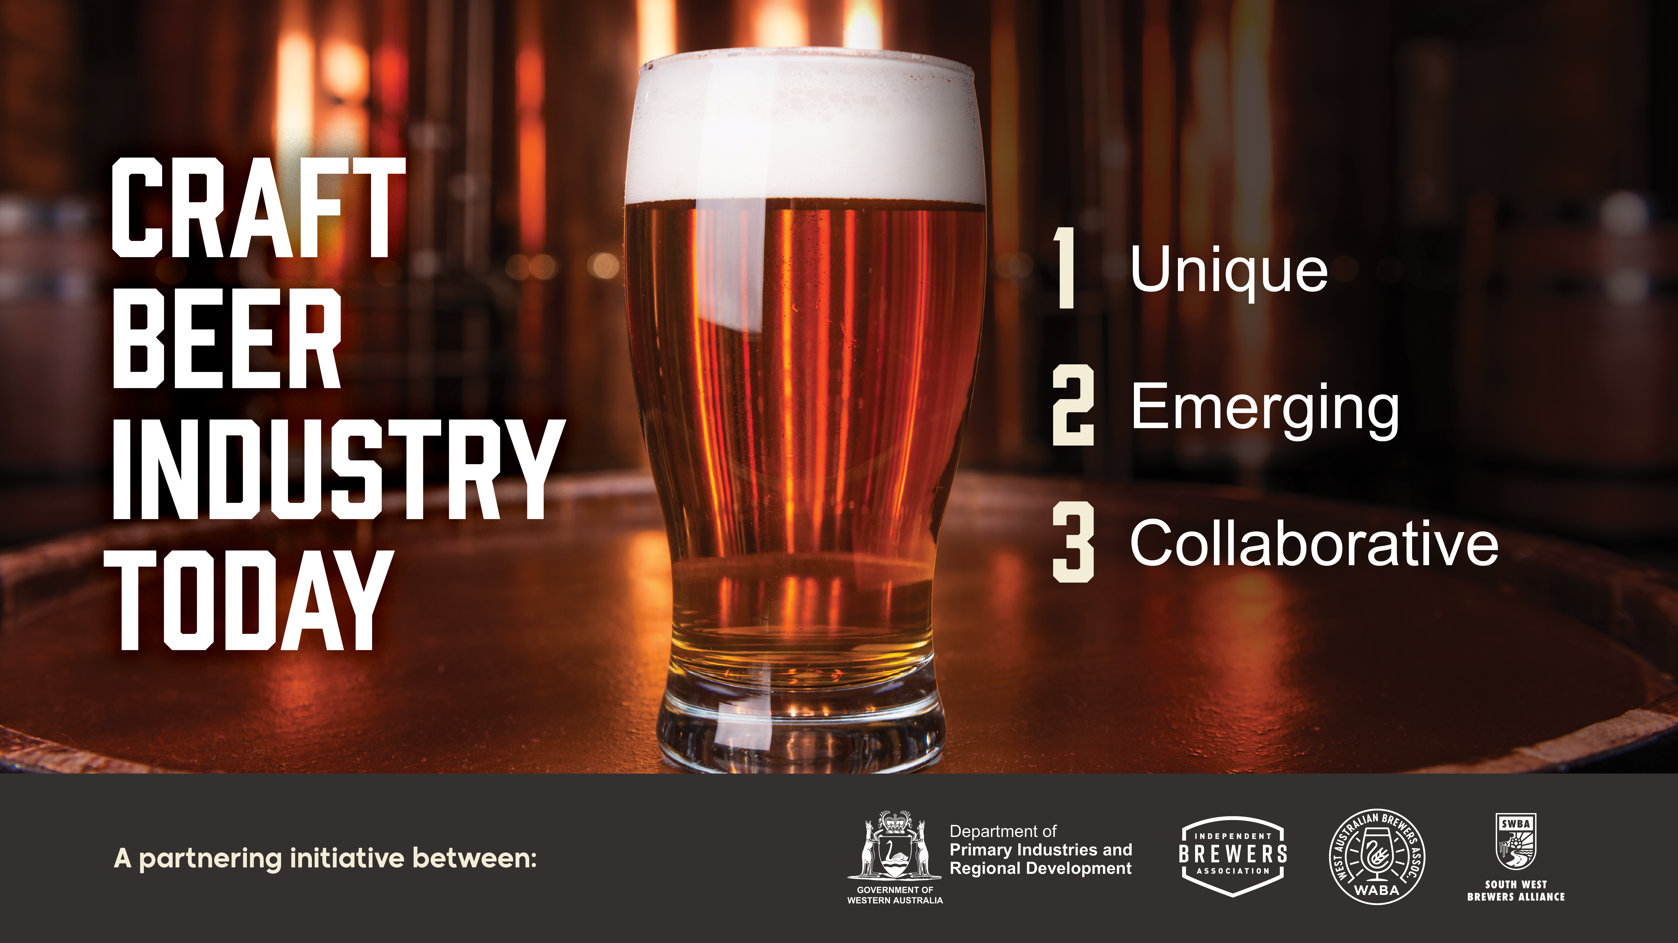
Notes:
(MC: Steven Blaine):
The insights from consultation with the WA craft beer supply chain identified themes that were common throughout WA that describe the industry today.
Unique
The WA craft beer industry has created its own unique structure and identity over many years, which differentiates it from other places around the world. It is predominantly made up of small to medium sized businesses, which source key inputs and supplies locally, and have a deep connection to the people and the region they are located in.
Emerging
The craft beer movement continues to grow in popularity, as consumers around the world seek out higher quality, distinctive and sustainably produced beer. The growth of the Western Australian craft beer industry reflects its capacity and drive to provide the experience sought by consumers
Collaborative
The WA craft beer industry is made up of breweries and the businesses in the supply chain that work well together but recognises the need for an industry strategy centred on a single vision to drive long term sustainable growth.

Slide 5
Notes:
(MC: Steven Blaine): Ask Michael to outline current economic contribution of industry
Michael:
WA is considered to be the birthplace of Australia’s craft beer industry. Since the establishment of a handful of now iconic breweries in Perth in the 1980’s and 1990’s there are currently over 120 craft beer brewing operations spread across the metropolitan area and in all the State’s regions, representing 20 per cent of the national industry.
ACIL Allen (report authors) estimate the beer manufacturing industry in Western Australia directly contributes $648.1 million to Gross State Product, and directly supports ~967 FTE jobs.
Indirectly, it supports more than 4,000 jobs across the State.

Slide 6
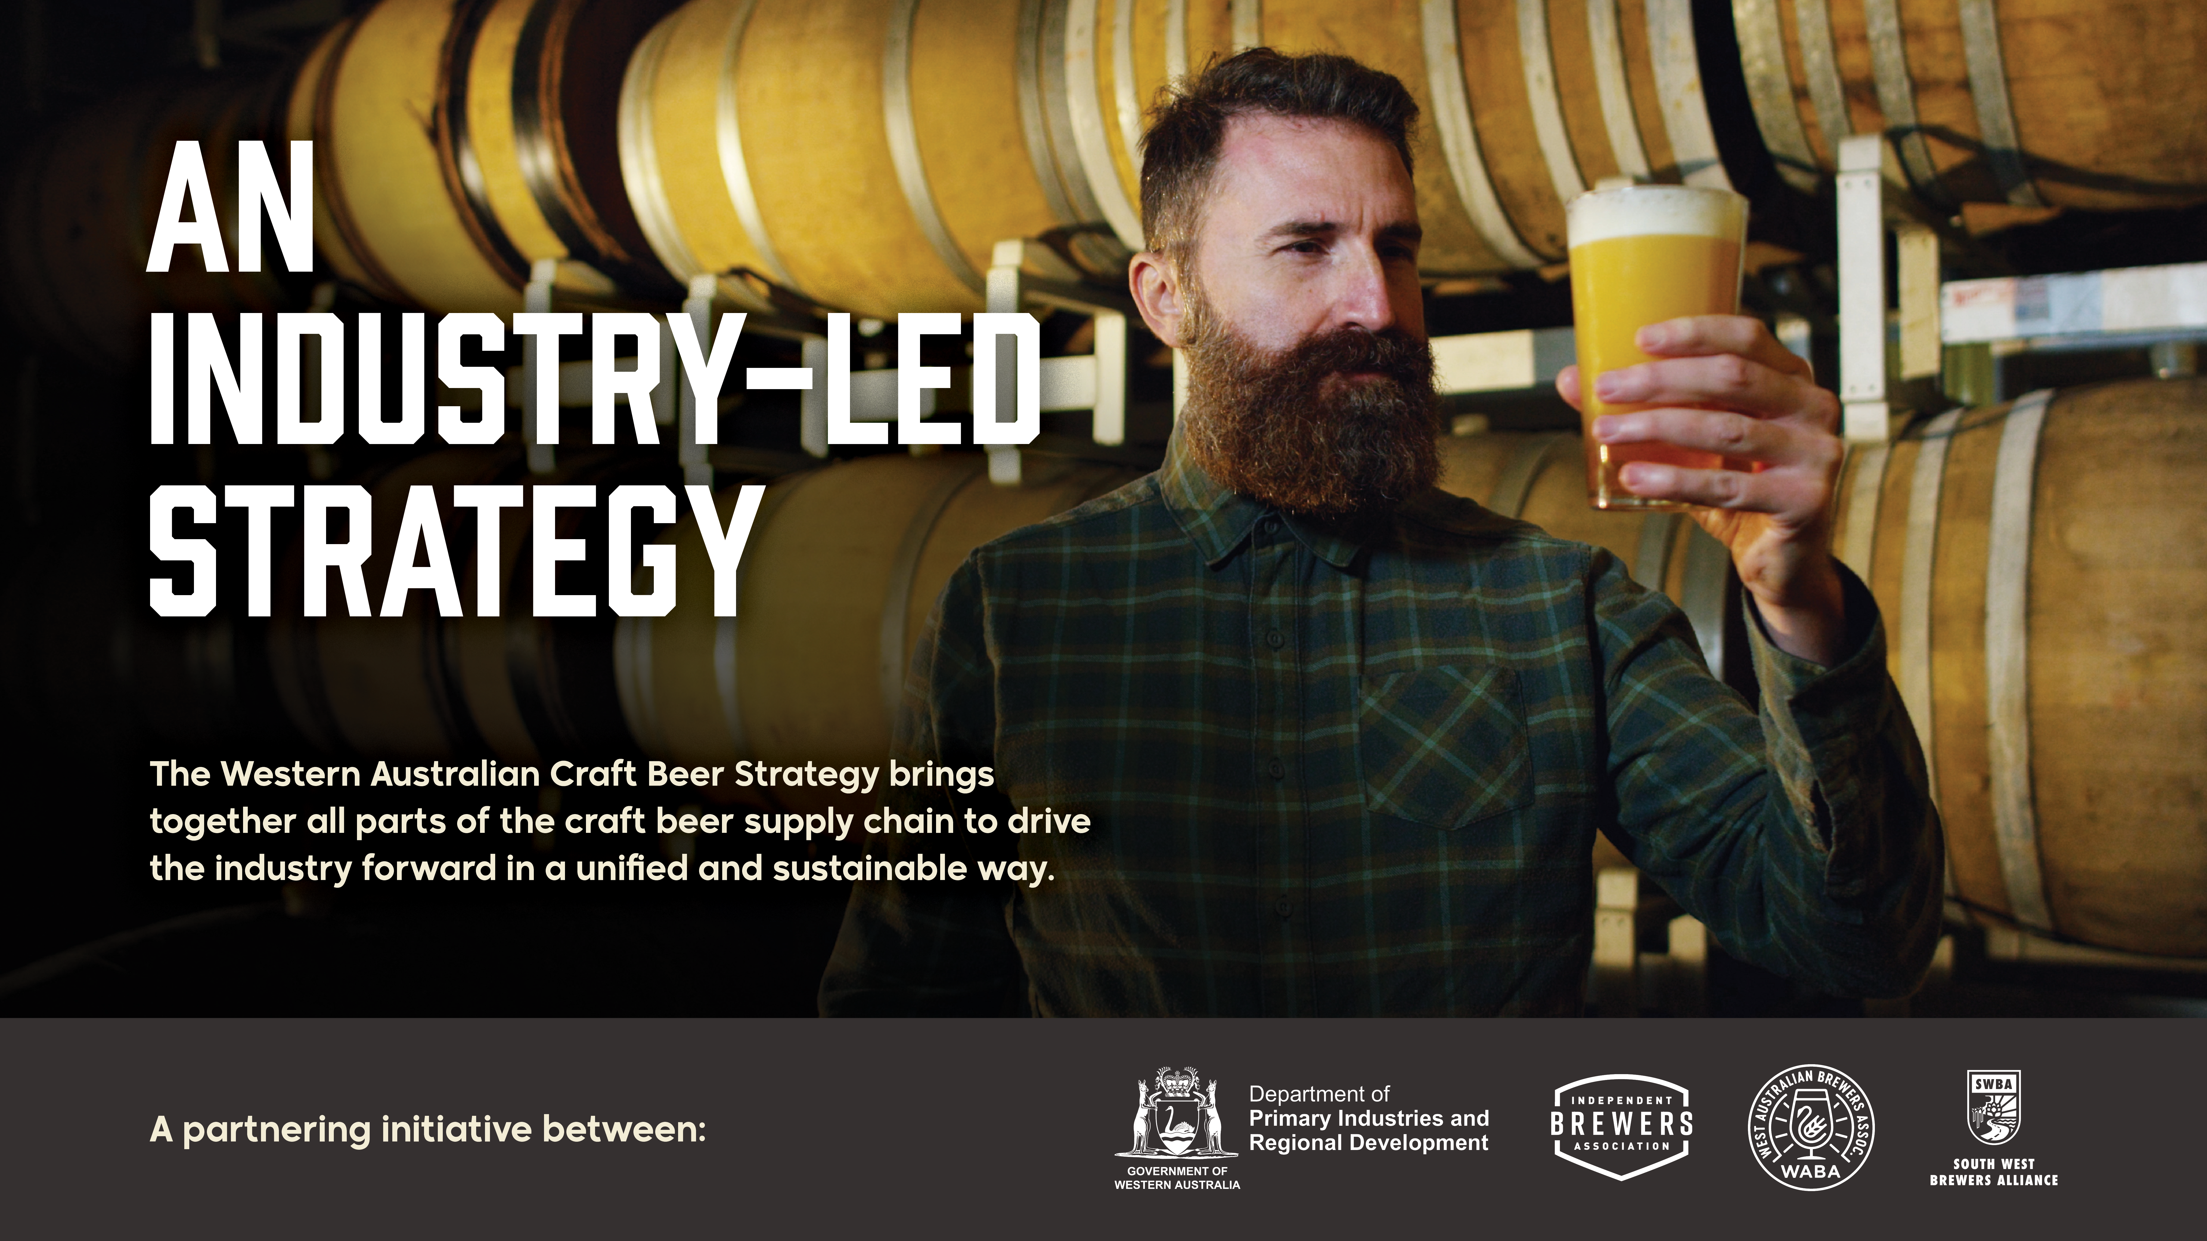
Notes:
(MC Steven Blaine):
Ask the panel to run through the agreed priorities that were identified in consultation with industry

Slide 7
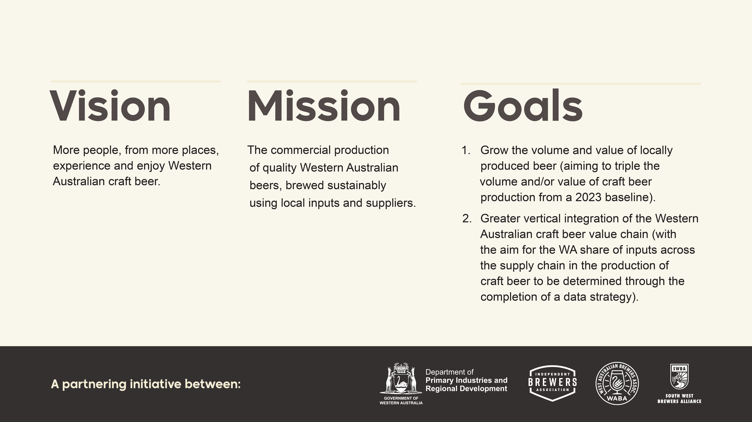
Notes:
Michael Morgan
Read the Vision, Mission and Goals identified through consultation

Slide 8
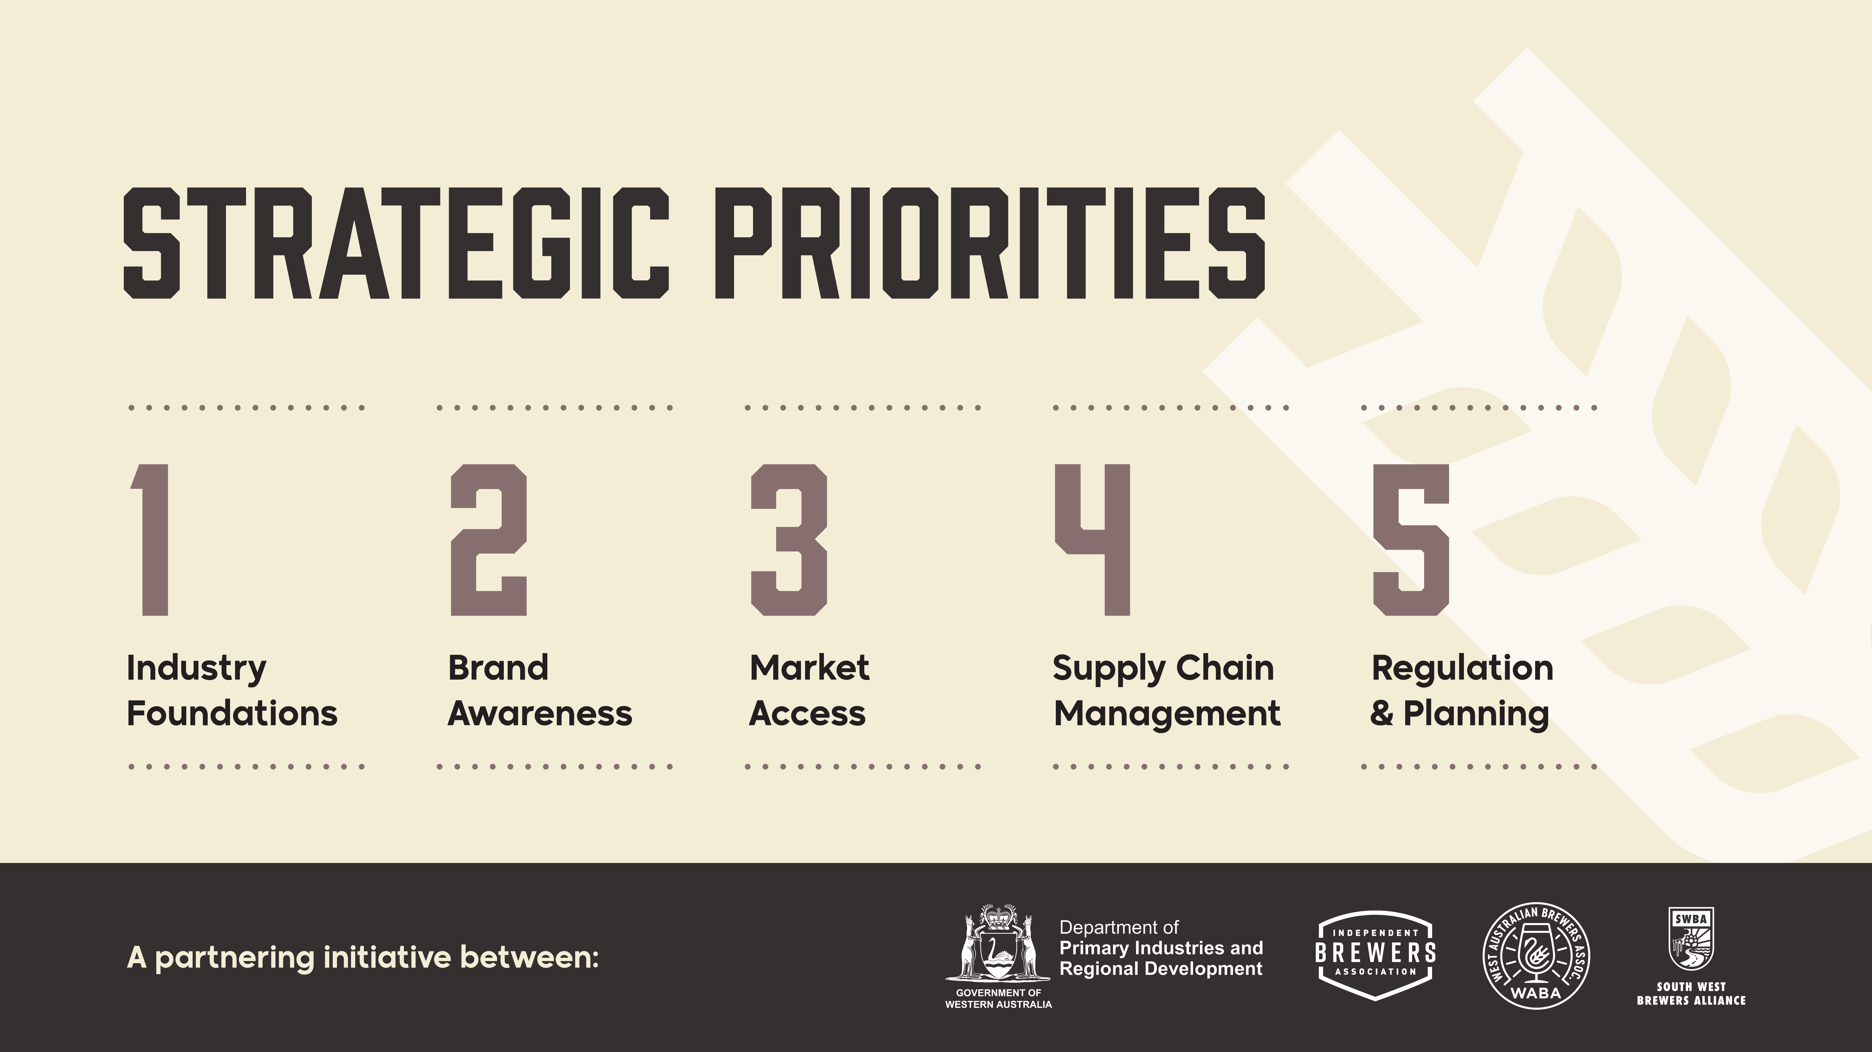
Notes:
Kylie Lethbridge
Introduce the 5 Priorities and then continue into … No 1: Industry Foundations

Slide 9
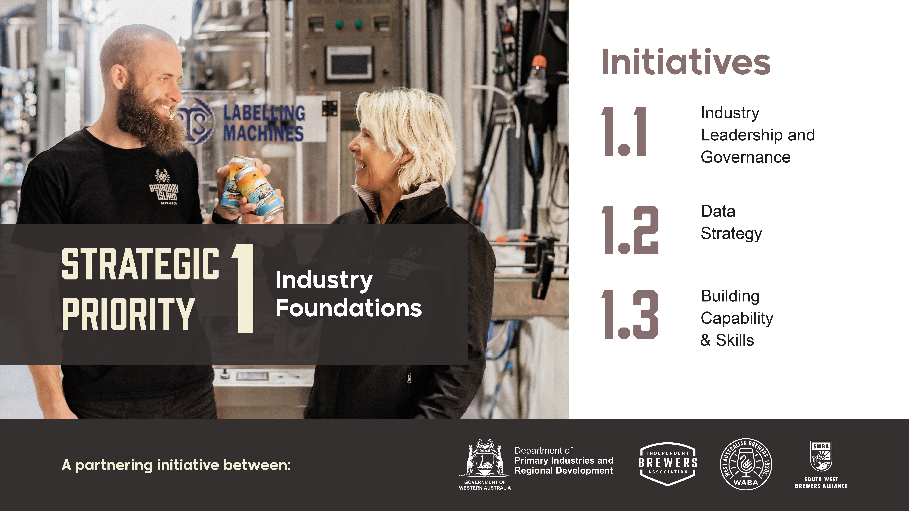
Notes:
Kylie Lethbridge
Through the creation of a single voice for industry, this strategic priority will focus on providing the leadership that will bring the strategy to life. This priority provides the foundation of the Strategy by providing the strong governance to own the Strategy and drive the initiatives to deliver the achievement of its vision, mission and goals.
Initiatives
1.1 Industry Leadership and Governance: The establishment of a single voice for the Western Australian craft beer industry to promote the industry and its long-term growth and development. The model, led by industry, should complement the existing industry organisations including IBA, WABA, and SWBA.
1.2 Data Strategy: To support the capture of critical industry data to support the growth and development of the industry. This should be facilitated through the new leadership, governance and advocacy model.
1.3 Building Capability & Skills: Build the capability of the industry, its business owners and its workforce through the development of training support packages and workforce training packages to grow the future workforce and attract new people to the industry.

Slide 10
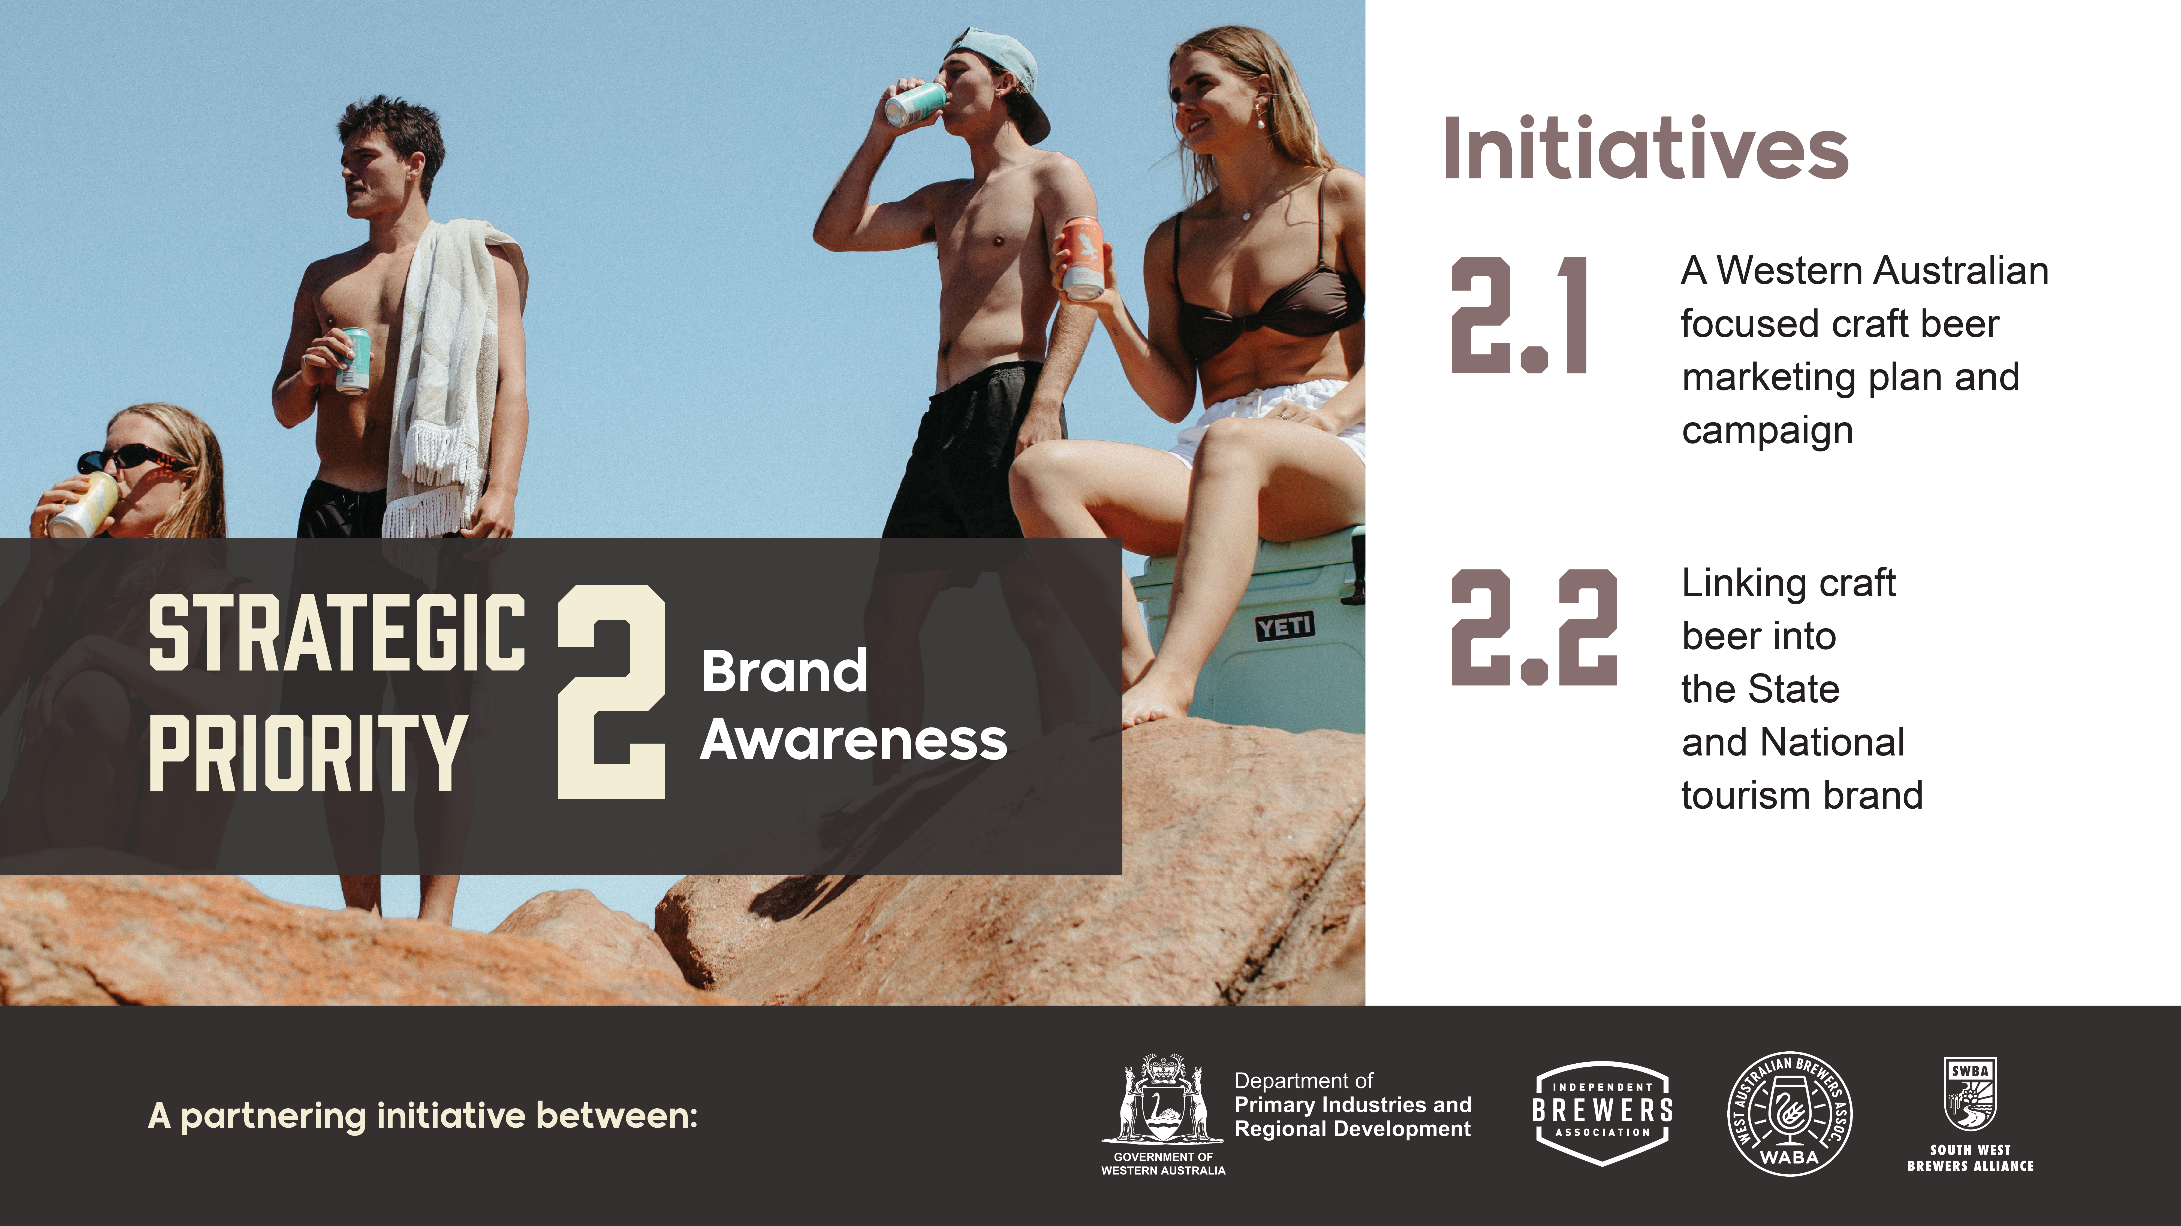
Notes:
Keith Warrick
This priority will focus on building the brand awareness of Western Australian craft beer to markets locally, nationally and globally by
implementing a craft beer marketing plan and campaign, and by linking craft beer into the WA tourism brand.
Initiatives
2.1 A Western Australian focused craft beer marketing plan and campaign
Develop a refreshed marketing plan and campaign to promote what makes the Western Australian craft beer industry unique. This could include cost effective promotion of the industry and advocacy with industry bodies that represent hospitality, tourism and retail sectors.
2.2 Linking craft beer into the State and National tourism brand
Incorporate craft beer into Australia’s and Western Australia’s offering as a destination for premium food and beverages.

Slide 11
Notes:
Susan (DPIRD programs) and Kylie (practical case studies)
This priority is focused on improving market access of Western Australian craft beer through improved access to distribution channels to local, interstate and overseas markets
Initiatives
3.1 Build domestic distribution channels to improve market penetration in Western Australia
Expand the opportunity for brewers to engage with and access local distribution networks such as retail outlets, pubs, restaurants, festivals and stadia.
3.2 Selling Western Australian craft beer to the world
Strategic industry market and export readiness through improved access to distribution channels and export capability building initiatives.
Susan
This priority has the opportunity to leverage existing DPIRD programs, including those offered through our Primary Industries Trade and Food Industry Development areas.
Within Primary Industries Trade, we have objectives focused on:
Market engagement, which has included trade exhibitions, in-bound and outbound delegations, and in-market promotions. This has resulted in export sales through activities such as Taste WA, and involvement in trade exhibitions such as Food Hotel Asia in Singapore.
Export capability building, which included export and domestic market pathways training and mentoring, and meet the buyer pitching preparation.
And export facilitation, including TradeStart advisory services which provides business focused client services and business matching.
These opportunities, and ongoing DPIRD objectives, will align with the strategy implementation plan.

Slide 12
Notes:
Michael
This priority aims to ensure the industry’s prosperity by enhancing the market depth and efficiency of the craft beer supply chain through research and development funding.
Initiatives
4.1 R&D Program to target supply chain sustainability
Investigate opportunities for research and development to support the creation of a more environmentally responsible supply chain by reducing emissions, addressing waste, and creating markets for by-products. Support research and development initiatives that target gaps in the craft beer industry supply chain.
4.2 A uniquely Western Australian supply chain
Industry led promotion of relevant programs and schemes of assistance to enhance the capability of the local supply chain and build business resilience.

Slide 13
Notes:
Kylie
This priority is targeted at ensuring industry works effectively with government to enable the growth, development and sustainability of the craft beer industry, in line with government’s broader economic development, diversification and decarbonisation agenda
Initiatives
5.1 Enhancing industry standards.
Develop a set of industry-led quality standards that reflect the structure and operations of the craft beer Industry.
5.2 Industry and government collaboration
Industry collaboration will guide strategy implementation and explore opportunities to effectively engage with the government on mechanisms that align with industry priorities.
5.3 Regulatory barriers
Identify land use planning, waste management, packaging, taxation, and health regulation impacting on growth and development issues in the craft beer industry.

Slide 14
Notes:
Contact details on back of brochure for further information
Download the summary document from the DPIRD and industry group websites
DPIRD display in Trade Area – talk to DPIRD staff (Jon Berry and David Leevers) who can walk through the full report findings and there is a demonstration of a cost-effective digital automation program currently being rolled out including several breweries and wineries

